Slide 1
Digital Frameworks
Class 2
Medill “on” the Hill
Randy Leonard
github.com/randyleonard99/digitalframeworks-spring2020

Slide 2

Tools of the trade
Tech that data journalists and visualizers use

Slide 3
The technology is somewhat arbitrary
Good data journalism comes from good ideas, done well, with solid data and execution.
The how of which computer language or technology was used is secondary.
This course focusses largely on the how-to of the first point. We’re addressing the second point today to pick one tool we’ll use as we make our way through the rest of the class.

Slide 4
The one site that will let you learn any tool
From Excel to coding, there is one website to go to to figure out how to get to the next step, no matter what step you’re on, no matter what tool you’re using.
This is that site.

Slide 5
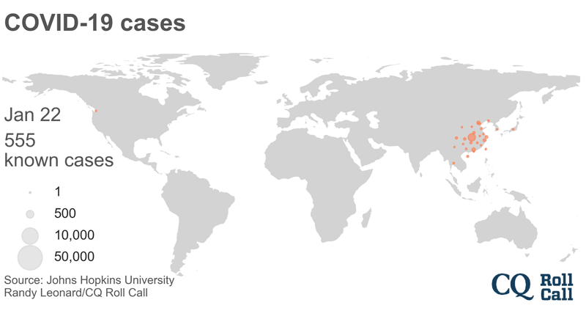
Personal story

Slide 8
Diving into some of the tools
Excel
Tableau
R
Python
D3
QGIS

Slide 9
Excel

Slide 10
Excel
Easily manipulate and clean data.
Quick on-the-fly aggregations, simple formulas
Interview data through sum, sort, filter – with quick simple charting.
Charts can be polished in Adobe Illustrator for publication.
Cons: limited analysis, aggregation and charting. Not generally repeatable.

Slide 11
Tableau

Slide 12
Tableau Public
Excellent data interviewing platform
Advanced aggregation, integrated formula queries
Fairly intuitive interface, advanced draft charting capabilities
Cons: Limited data capability, charts are difficult to polish in Illustrator.

Slide 13
R - RStudio

Slide 14
R
Run through Rstudio, R “provides a wide variety of statistical (linear and nonlinear modelling, classical statistical tests, time-series analysis, classification, clustering, …) and graphical techniques, and is highly extensible.
Highly modular, new components, or “packages” integrate seamlessly.
Advanced stats and other analysis, GIS, graphics production.
Repeatable processes.
Cons: Steeper learning curve than software tools.

Slide 15
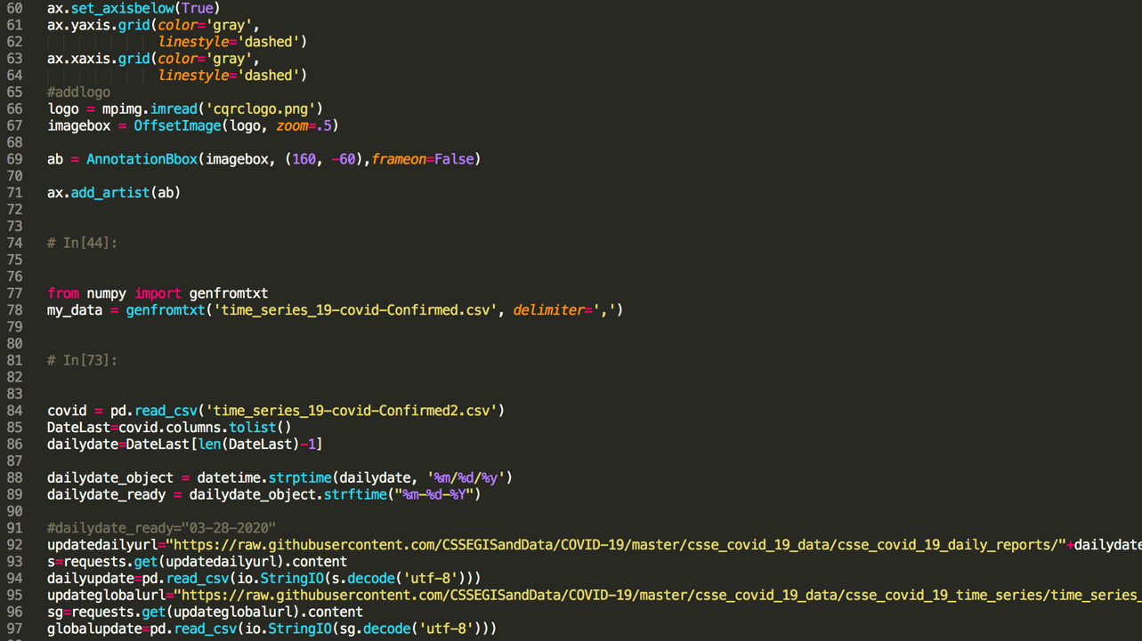
Python

Slide 16
Python
Coding language for data scraping, processing, wrangling and analysis.
Create bots, scrapers, computational scripts.
Repeatable, widely used.
Cons: Steep learning curve, complex setup.

Slide 17
D3

Slide 18
D3
Top tier JavaScript library for charting
Highly customizable, built for publishing web graphics and interactives
Cons: Requires finished data and needs HTML/JavaScript to display/publish

Slide 19
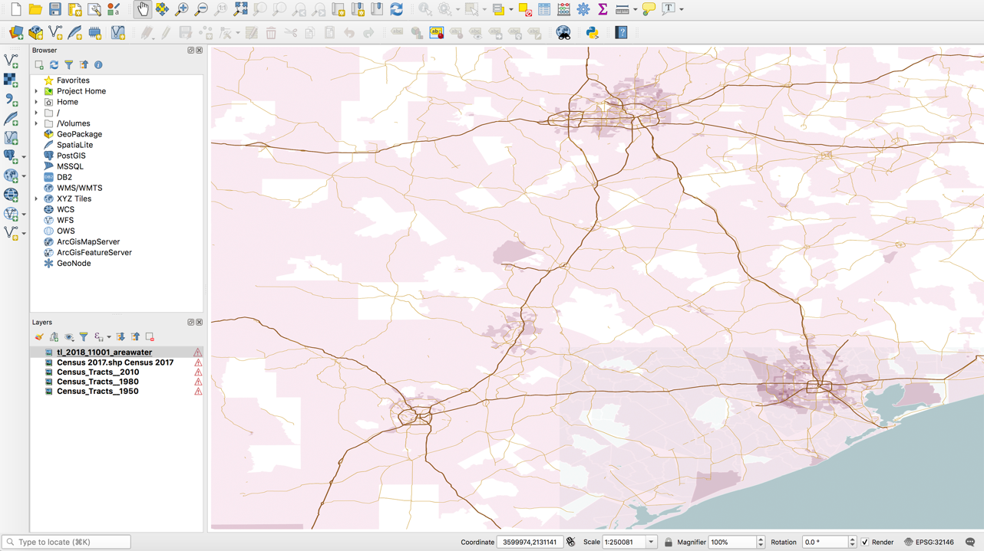
QGIS

Slide 20
GIS
QGIS (open source) and ESRI ArcGIS (industry best, free for journos).
Advanced geospatial analysis and mapping.
Aggregate by location, find within distances.
Produce wide variety of maps, suitable for polishing in Illustrator.
ArcGIS has web platforms for sharing/ ok production value.
Cons: Limited to spatial analysis and map production.

Slide 21
Other resources
NICAR-L listserve – conversations on these and more tools, archives online
stackoverflow – coding Q&A
Excel magic – tips and tricks from MaryJo Webster of the Star Tribune
Tableau Public resources – tutorials and Q&A
Getting started in RStudio, by Peter Aldhous of BuzzFeed
First Python notebook – step by step setup and intro to Python
Beginning D3 – NICAR session by Darla Cameron of Texas Tribune
Sublime Text – free text editor for coding (or VS Code)
Making maps with QGIS - by Peter Aldhous of BuzzFeed

